Slide 1

predicting wine quality
FORECASTING RATINGS BASED ON WINE ATTRIBUTES
Laura Larregui, Angela Garcia, John Christman

Slide 2


Predicting Wine Quality
BUSINESS CASE:
Creating a model that evaluates wine quality, will benefit the wineries by allowing them to evaluate small batches before beginning full production.
Additional analytics provided will support different quality setups to drive higher ratings for red wine vs white
MAIN GOALS:
To create a model that predicts the rating of a wine.
Understand which variables are responsible for the quality of the wine.
MAIN QUESTIONS
What is the minimum set of properties and their values that define a high-quality wine?
Are there common factors in the predictability of red wine and white wine?

Slide 3
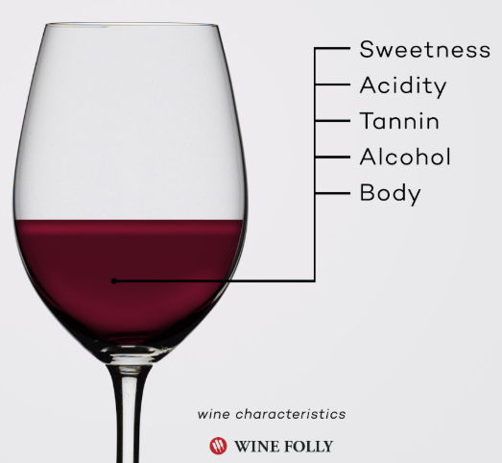
Predicting Wine Quality
DATA SET INFO
Wine Quality dataset. University of California, Irvine Machine Learning repository.
Used two datasets related to red and white variants of the “Vinho Verde” a Portuguese wine.
Data Characteristics:
Multivariate
Number of Instances: Red: 1599 and White 4898
Attributes: 12 each
Associated Tasks: Classification, Regression
WINE ATTRIBUTES:​
Input variables (based on physicochemical tests)
Fixed acidity.
Volatile acidity
Citric acid
Residual sugar
Chlorides
Free sulfur dioxide
Total sulfur dioxide
Density
pH
Sulphates
Alcohol
Output Variable: Quality.
Score between 0 and 10. Based on sensory data
Notes:
To simplify the analysis we would concentrate in 5 of the main characteristics of wine by “Wine Folly”
Fixed acidity: Nonvolatile
Volatile acidity: Acetic acid. Causes vinegar taste
Citric acid: Adds 'freshness' and flavor
Residual sugar: Sugar after fermentation.
Chlorides: Salt
Free sulfur dioxide: Prevents microbes & oxidation
Total sulfur dioxide: Free S02 + Bound S02. @ Free S02 > 50 ppm impacts smell and taste
Density: Driven by alcohol % and sugar content
pH: Acidic or basic. Where 0 is very acidic and 14 very basic. Most wines are 3-4 on the pH scale
Sulphates: Associated to S02 gas levels. Aids in preventing microbes & oxidation
Alcohol: Percent of alcohol content
Quality: Output variable based on sensory data. Range: 0 - 10
#https://winefolly.com/review/wine-characteristics/

Slide 4
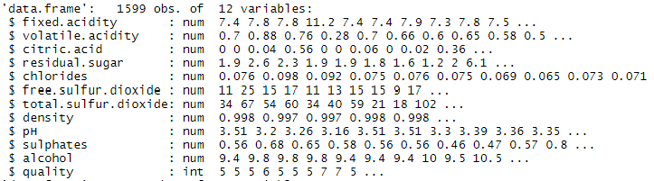
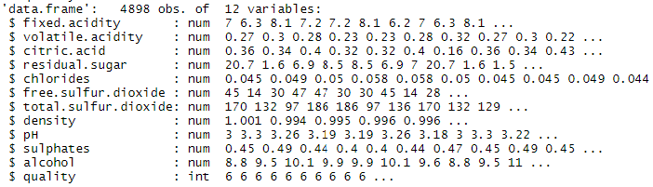
Predicting Wine Quality
DATA SETUP
CONFIRMING DATA STRUCTURE
Identifying Data Issues
Only one column of data, with column names separated by periods and data points separated by semi-colons
Data Cleansing
Separate the data into columns
Create column names
Verify/eliminate NAs
Red Wine
White Wine
2 Datasets. 12 variables. Mostly number format. 6,497 observations

Slide 5
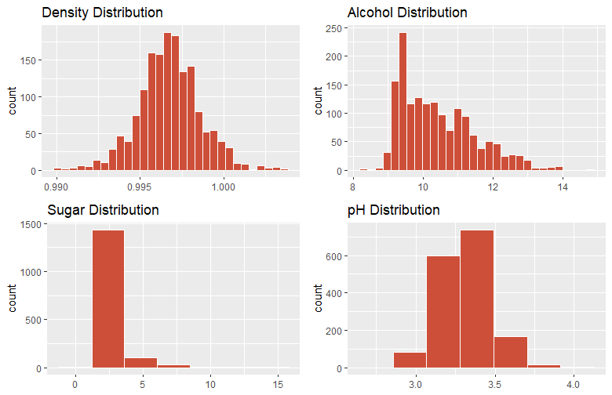
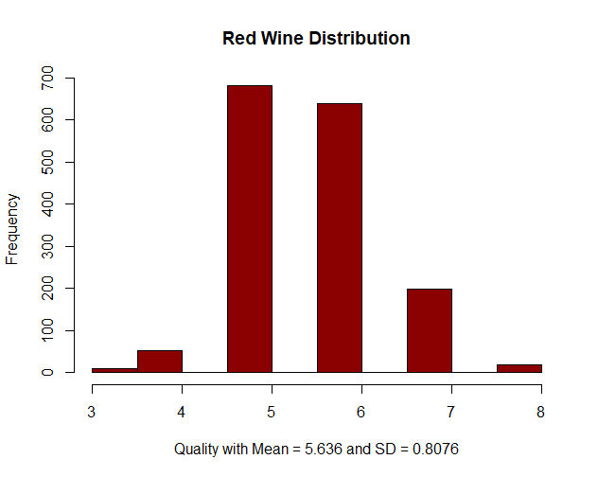
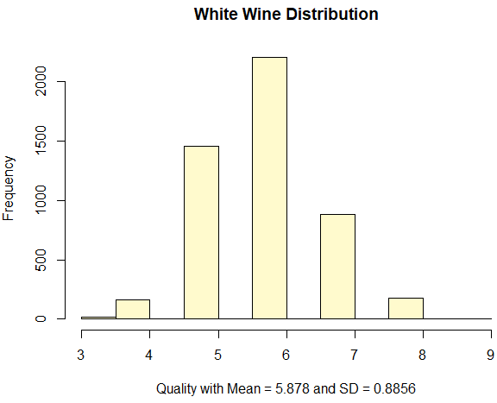
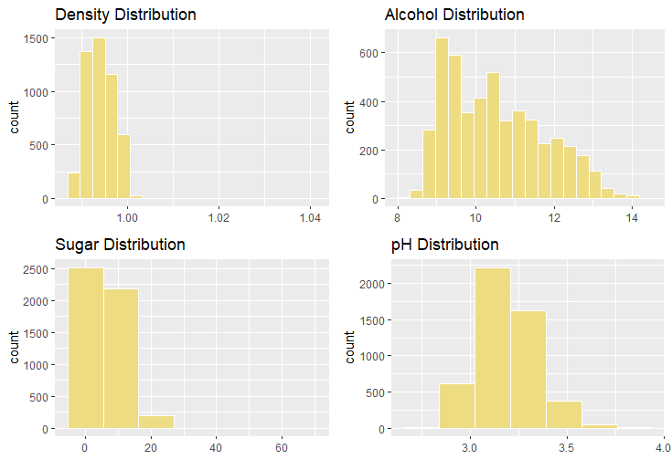
Predicting Wine Quality
DISTRIBUTIONS
Red Wine
ATT | Mean | SD
D | 0.9967 | 0.8076
A | 10.42 | 1.066
S | 2.539 | 1.4099
pH | 3.311 | 0.1544
Similar pH and Alcohol but ≠ Sugar and Density
White Wine
ATT | Mean | SD
D | 0.9940 | 0.8856
A | 10.51 | 1.230
S | 6.391 | 5.0720
pH | 3.188 | 0.1510
Similar Quality Distributions
Notes:
Similar Quality Distributions with similar means (5.636 vs 5.878) and similar standard deviations (0.8076 vs 0.8856)
Attributes distributions also similar except for Residual Sugar with means of (2.539 vs 6.391) and standard deviations of (1.41 vs 5.1)

Slide 6
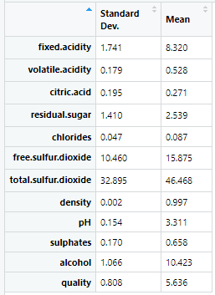
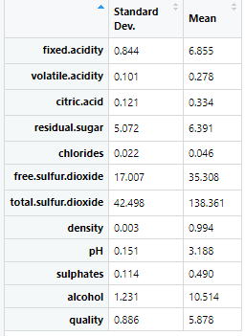
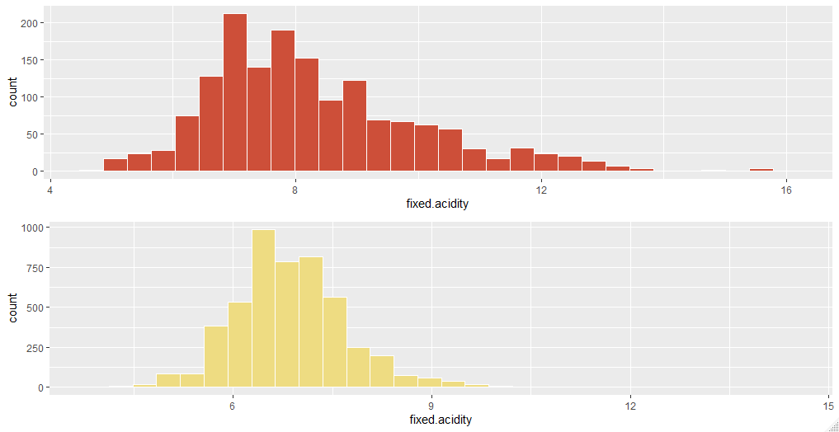
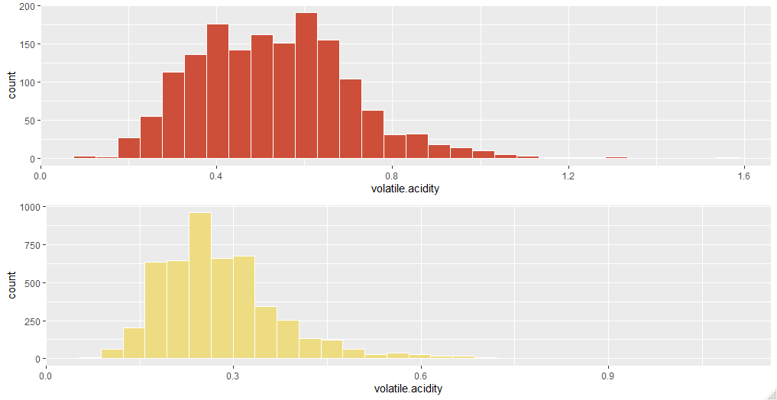
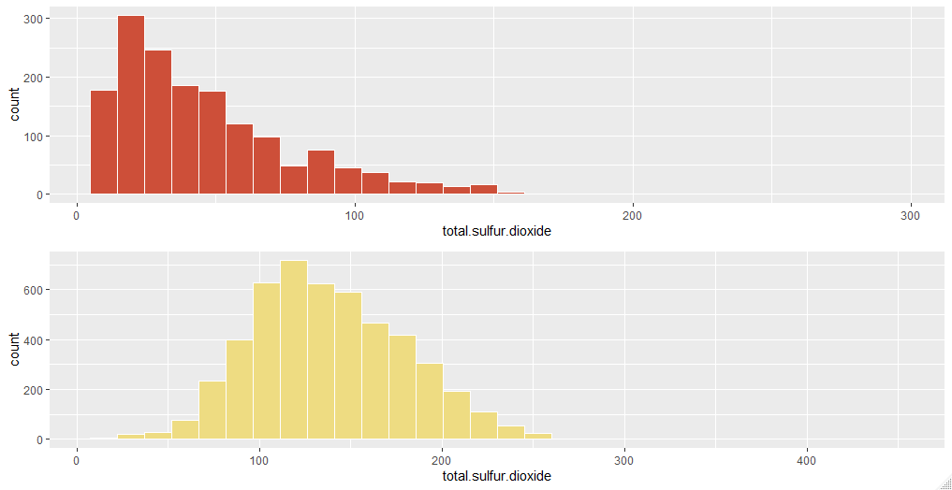
Predicting Wine Quality
DISTRIBUTIONS
Red Wine
White Wine
Evaluation of the other distributions show very similar distributions for both red and white wine except for Sulfur Dioxide (both free and total)
A few more variables had a higher average but they all looked normally distributed with a right skew
Fixed Acidity
Volatile Acidity
Free Sulfur Dioxide
Total Sulfur Dioxide
Notes:
Data was normalized in some instances to eliminate outliers

Slide 7
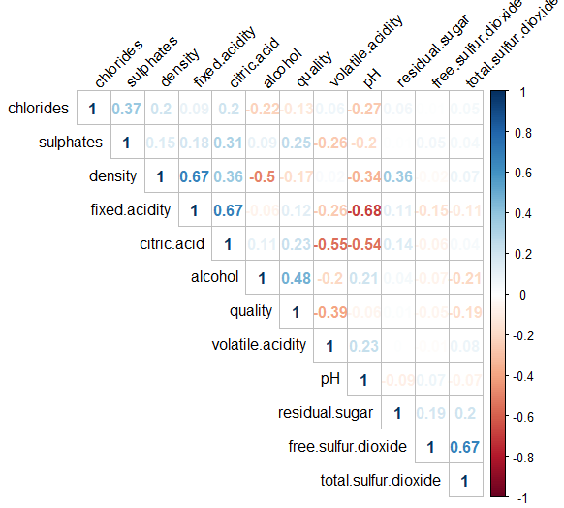
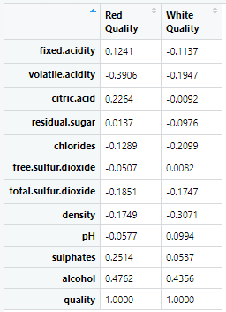
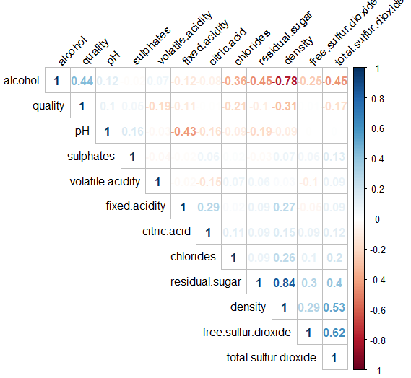
Predicting Wine Quality
CORRELATIONS
Highest correlations are between attributes not to Quality.
Highest Positive correlation White wine at r= 0.84 for Density and Sugar which has a much lower value (r=0.36) for Red wine
Highest negative correlation also White wine at (r=-0.78) for Density and Alcohol. Vs (r=-0.5) for Red wine
Red Wine
Highest Positive correlation to Quality for both Red and White wine is Alcohol
Highest Negative correlations:
Volatile Acidity for Red
Density for White wine
White Wine
Notes:
For Red Wine the highest correlations are
Density and Fixed Acidity (r=0.67). Positive Correlation
Fixed Acidity and Citric Acid (r= 0.67) Positive Correlation
Fixed Acidity and pH (r=-0.68). Negative Correlation
Citric Acid and Volatile Acidity (r=-0.55) Negative Correlation
The Free Sulfur Dioxide and Total Sulfur Dioxide correlation (r=0.67) is insignificant because free sulfur dioxide is included into the total sulfur
For White Wine, the highest Correlations are
Density and Residual Sugar (r=0.84) High Positive Correlation. Highest of all if you compare Red and White
Density and Total Sulfur Dioxide (r=0.45). Positive Correlation
Density and Alcohol (r= -0.78). Negative Correlation
Alcohol and Residual Sugar (r=-0.45) Negative Correlation

Slide 8
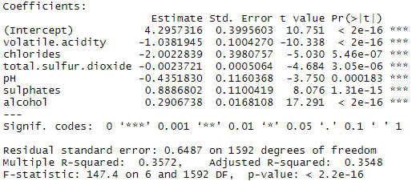
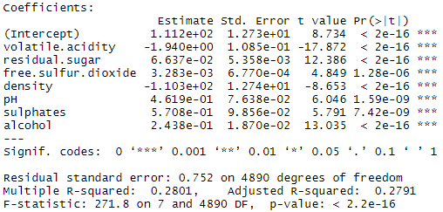
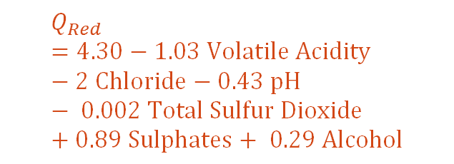
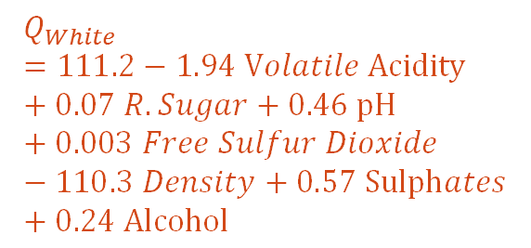
Predicting Wine Quality
DEFINE THE QUALITY MODEL
Linear Model – Red Wine
Approach
Run LM for all attributes
Run LM for attributes statistically significant
$$Q_{Red}=4.30−1.03 Volatile Acidity −2 Chloride−0.43 pH− 0.002 Total Sulfur Dioxide +0.89 Sulphates+ 0.29 Alcohol$$
Linear Model – White Wine
Determination Coefficient: 35.48% of Quality can be explained by these attributes
$$Q_{White}=111.2−1.94 Volatile Acidity+0.07 R.Sugar+0.46 pH+0.003 Free Sulfur Dioxide−110.3 Density+0.57 Sulphates+0.24 Alcohol$$
Determination Coefficient: 27.91% of Quality can be explained by these attributes
Notes:
Volatile acidity: Causes vinegar taste
Chlorides: Salt
Total sulfur dioxide: Free S02 + Bound S02. @ Free S02 > 50 ppm impacts smell and taste
pH: Acidic or basic. Where 0 is very acidic and 14 very basic. Most wines are 3-4 on the pH scale
Sulphates: Associated to S02 gas levels. Aids in preventing microbes & oxidation
Alcohol: Percent of alcohol content
Quality: Output variable based on sensory data. Range: 0 - 10

Slide 9
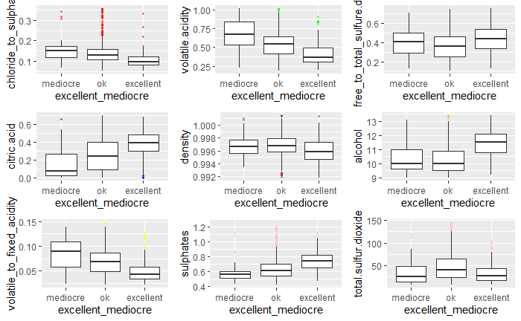
categorical Quality
RED WINE
Notes:
Added we added another attribute to our dataset. We consolidated quality by:
Mediocre (3-4)
Ok (5-6)
Excellent (7-8)
The following variables correlate inversely with quality (i.e. quality decreases as these variables increase in value):
chloride:sulphate ratio
volatile acidity
Volatile:fixed acidity ratio
density
The following variables correlate with quality (i.e. quality increases as these variables increase in value):
alcohol content
citric acid
sulphates

Slide 10
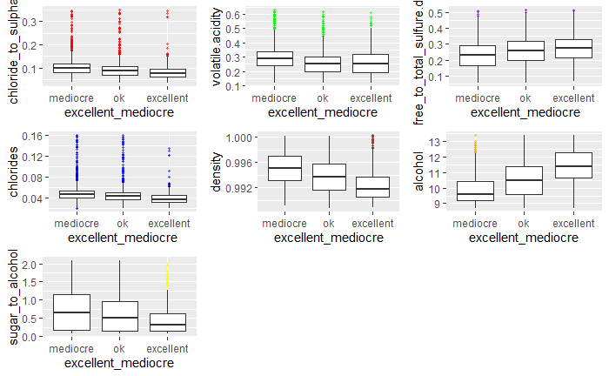
CATEGORICAL Wine Quality
WHITE WINE
Notes:
Added we added another attribute to our dataset. We consolidated quality by:
Mediocre (3-5)
Ok (6)
Excellent (7-9)
The following variables correlate inversely with quality (i.e. quality decreases as these variables increase in value):
chloride:sulphate ratio
volatile acidity
chlorides
density
sugar: alcohol ratio
The following variables correlate with quality (i.e. quality increases as these variables increase in value):
alcohol content
free: total sulfure dioxide

Slide 11
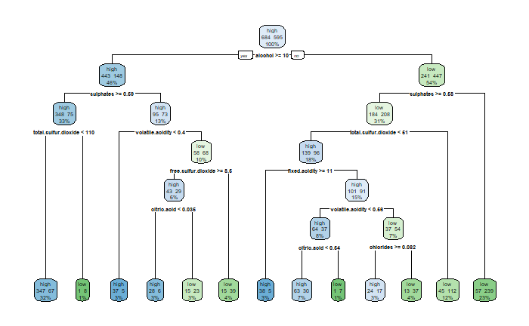


predicting wine quality
PREDICTIONS RED WINE - RPART

Slide 12

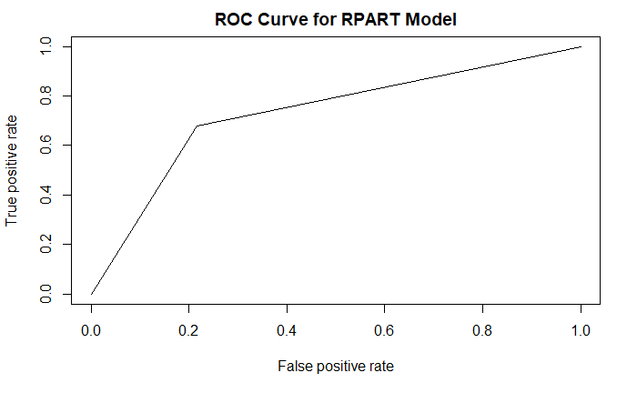
predicting wine quality
C50 Model
146 correctly classified (46%)
174 incorrectly classified (54%)
Tree Model
155 correctly classified (48%)
165 incorrectly classified (52%)
RPart Model
156 correctly classified (49%)
164 incorrectly classified (51%)
the area under the curve value for the tree model = 0.730739
the misclassification error for this model is 51.25%
PREDICTING RED WINE – RPART (CONT.)
Test |  | Predicted
 | High | Low
High | 95 | 77
Low | 87 | 61
Notes:
The graph: shows the correctly and incorrectly classified instances
C50 Model
146 correctly classified (46%)
174 incorrectly classified (54%)
Tree Model
155 correctly classified (48%)
165 incorrectly classified (52%)
RPart Model
156 correctly classified (49%)
164 incorrectly classified (51%)

Slide 13
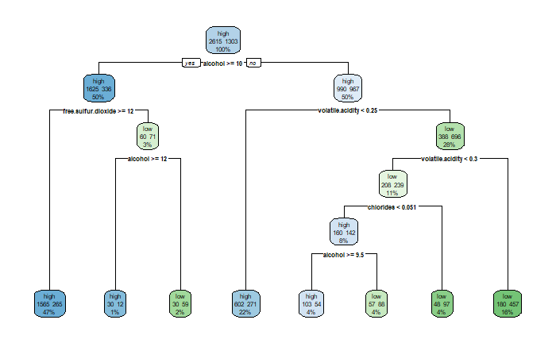
predicting wine quality
PREDICTIONS WHITE WINE - RPART

Slide 14
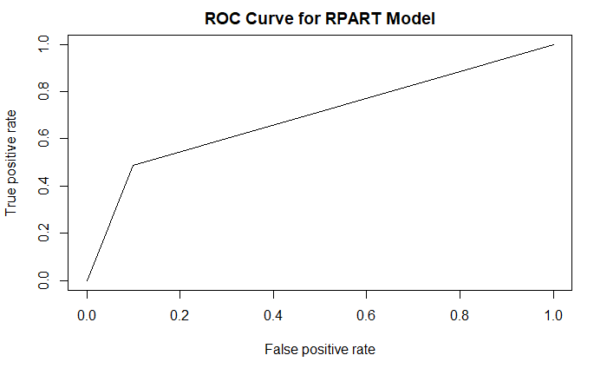
predicting wine quality
C50 Model
557 correctly classified (57%)
423 incorrectly classified (43%)
Tree Model
557 correctly classified (57%)
423 incorrectly classified (43%)
RPart Model
557correctly classified (57%)
423incorrectly classified (43%)
the area under the curve value for the tree model = 0.6935567
the misclassification error for this model is 40%
DECISION TREES WHITE WINE – RPART (CONT.)
Test |  | Predicted
 | High | Low
High | 510 | 156
Low | 242 | 72

Slide 15
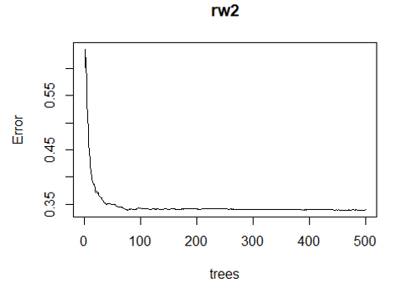
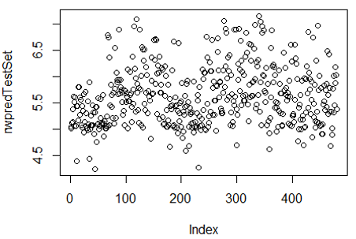
Predicting Wine Quality
RANDOM FOREST
Red Wine Quality
Inputs: Volatile Acidity, Chlorides, Total Sulfur Dioxide, pH, Sulphates, Alcohol
Type of random forest: regression Number of trees: 500 No. of variables tried at each split: 6 Mean of squared residuals: 0.3395346 % Var explained: 45.98
Attribute | %IncMSE | IncNodePurity
volatile.acidity | 36.57 | 108.43
chlorides | 32.11 | 75.05
ttal.sulfur.dioxide | 35.96 | 83.64
pH | 23.77 | 64.96
sulphates | 52.47 | 107.80
alcohol | 79.27 | 233.21
The mean of values where the predicted value equals actual is 0.625

Slide 16
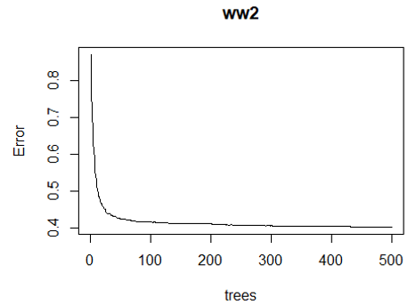
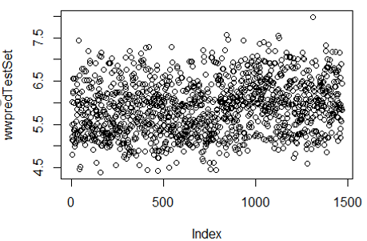
Predicting Wine Quality
RANDOM FOREST
White Wine Quality
Inputs: Volatile Acidity, Residual sugar, Free Sulfur Dioxide, Density, pH, Sulphates, Alcohol
Type of random forest: regression Number of trees: 500 No. of variables tried at each split: 6 Mean of squared residuals: 0.4033124 % Var explained: 49.55
Attribute | %IncMSE | IncNodePurity
volatile .acidity | 117.94 | 419.51
residual.sugar | 67.11 | 282.93
free.sulfur.dioxide | 86.91 | 394.83
density | 49.21 | 310.15
pH | 60.02 | 284.45
sulphates | 55.47 | 241.36
alcohol | 124.94 | 692.08
The mean of values where the predicted value equals actual is 0.6605

Slide 17

Our QUESTIONS
Understand which variables are responsible for the quality of a wine. Yes (statistically significant)
Model that predicts the rating of a wine. Yes. Linear Model gave as an equation and Random Forest was the best prediction model
Are there common factors in the predictability of red wine and white wine? Yes. Volatile Acidity, pH, Sulphur and Alcohol
your QUESTIONS
Our CHALLENGES
Data complexity: Many variables, many relationships many possible outcomes
Only considering chemical attributes
Industry standards are not based on a 1-10 scale.
We are only considering one wine type
Sample data did not have values on the higher end of the spectrum.
A little bit more chemical knowledge would have been great
Notes:
Wine Spectators 100 point scale is commonly used industry standard
Proves the test case. A more robust approach would be needed to produce a viable business product

